Slide 1
Bandwidth Utilization: Multiplexing and Spreading
Multiplexing
Spread Spectrum

Slide 2
Bandwidth Utilization
Bandwidth utilization is the wise use of available bandwidth.
- sometimes we need to combine several low-bandwidth channels to make use of one channel with a larger bandwidth.
- sometimes we need to expand the bandwidth of a channel to achieve goals such as privacy and antijamming.
Two categories: multiplexing and spreading.
Efficiency can be improved by multiplexing.
With spreading privacy and anti-jamming can be achieved.

Slide 3

Multiplexing
Whenever the bandwidth of a medium linking two devices is greater than the bandwidth needs of the devices, the link can be shared.
Multiplexing is the set of techniques that allows the simultaneous transmission of multiple signals across a single data link.
In a multiplexed system, n lines share the bandwidth of one link.
The lines on the left direct their transmission streams to a MUX, which combines them into a single stream. At the receiving end, that stream is fed into a DEMUX, which separate the stream back into its component transmissions and directs them to their corresponding lines.
The word link refers to the physical path, whereas the word channel refers to the portion of a link that carries a transmission between a given pair of lines.

Slide 4

Categories of Multiplexing

Slide 5

Frequency Division Multiplexing (FDM)
It is an analog multiplexing technique that combines analog signals.
Signals generated by each sending device modulate different carrier frequencies.
These modulated signals are combined into a single composite signal that can be transported by the link.
Channel - Bandwidth range to accommodate a modulated signal
Channels can be separated by strips of unused bandwidth – guard bands – to prevent overlapping.
In many cases, such as radio and television broadcasting, there is no need for a physical multiplexer or demultiplexer. As long as the stations agree to send their broadcasts to the air using different carrier frequencies, multiplexing is achieved.

Slide 6

Multiplexing Process
Each source generates a signal of a similar frequency range. Inside the multiplexer, these similar signals modulates different carrier frequencies (f₁, f₂, and f₃). The resulting modulated signals are then combined into a single composite signal that is sent out over a media link that has enough bandwidth to accommodate it.

Slide 7

Demultiplexing Process
The demultiplexer uses a series of filters to decompose the multiplexed signal into its constituent component signals. The individual signals are then passed to a demodulator that separates them from their carriers and passes them to the output lines.

Slide 8

Example 1: Assume that a voice channel occupies a bandwidth of 4kHz. We need to combine three voice channels into a link with a bandwidth of 12khz, from 20 to 32 kHz. Show the configuration, using the frequency domain. Assume there are no guard bands.

Slide 9

Example 2: Five channels, each with a 100-kHz bandwidth, are to be multiplexed together. What is the minimum bandwidth of the link if there is a need for a guard band of 10khz between the channels to prevent interference?

Slide 10
Analog Hierarchy
To maximize the efficiency of their infrastructure, telephone companies have traditionally multiplexed signals from lower-bandwidth lines onto higher-bandwidth lines.
One of these hierarchical systems used by AT&T is shown in fig.
In this analog hierarchy, 12 voice channels are multiplexed onto a higher-bandwidth line to create a group. A group has 48 kHz of bandwidth and supports 12 voice channels.
At the next level, ……………..

Slide 11
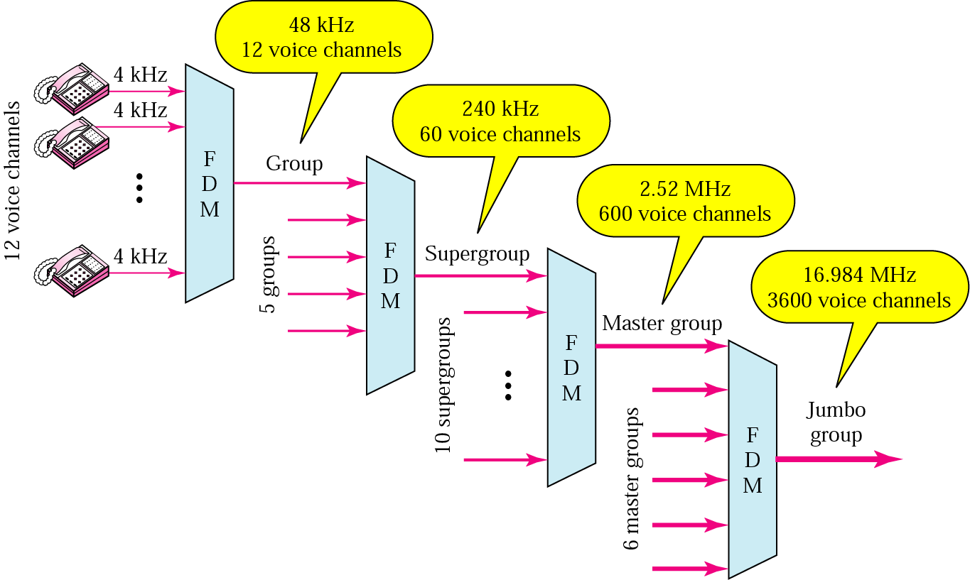

Slide 12

Wavelength Division Multiplexing
is designed to use the high-data-rate capability of fiber-optic cable.
Analog multiplexing technique to combine optical signals.
Conceptually the same as FDM
Light signals transmitted through fiber optic channels
Combining different signals of different frequencies (wavelengths).
Very narrow bands of light from different sources are combined to make a wider band of light. At the receiver, the signals are separated by the demultiplexer.

Slide 13

Combining and splitting of light sources are easily handled by a prism.
Prism bends a light beam based on the incidence angle and the frequency.
One application of WDM is the SONET network in which multiple optical fiber lines are multiplexed and demultiplexed.

Slide 14

Time Division Multiplexing
Digital multiplexing technique for combining several low-rate channels into one high-rate one.
Instead of sharing a portion of the bandwidth an in FDM, time is shared.
Each connection occupies a portion of time in the link.
Note that in fig., we are concerned with only multiplexing, not switching.
TDM is divided into two different schemes: synchronous and statistical.

Slide 15
Synchronous TDM
Time Slots and Frames
Each input connection has an allotment (time slot) in the output even if it is not sending data.
The data flow of each input connection is divided into units, where each input occupies one input time slot. A unit can be 1 bit, one character, or one block of data. Each input unit becomes one output unit and occupies one output time slot.
However, the duration of an output time slot is n times shorter than the duration of an input time slot. If an input time slot is T s, the output time slot is T/n s, where n is the number of connections.
A round of data units from each input connection is collected into a frame. If we have n connections, a frame is divided into n time slots and one slot is allocated for each unit, one for each input line. If the duration of the input unit is T, the duration of each slot is T/n and the duration of each frame is T.
The data rate of the link is n times faster, and the unit duration is n times shorter.

Slide 16

Synchronous TDM

Slide 17
Example 1:
Four 1-Kbps connections are multiplexed together. A unit is 1 bit. Find (a) the duration of 1 bit before multiplexing, (b) the transmission rate of the link, (c) the duration of a time slot, and (d) the duration of a frame?
a) The duration of 1 bit is 1/1 Kbps, or 0.001 s (1 ms).
b) The rate of the link is 4 Kbps.
c) The duration of each time slot 1/4 ms or 250 μs.
d) The duration of a frame 1 ms.

Slide 18

Interleaving
TDM can be visualized as two fast-rotating switches, one on the multiplexing side and the other on the demultiplexing side. The switches are synchronized and rotate at the same speed, but in opposite directions. On the multiplexing side, as the switch opens in front of a connection, that connection has the opportunity to send a unit onto the path. This process is called interleaving. On the demultiplexing side, as the switch opens in front of a connection, that connection has the opportunity to receive a unit from the path.
Interleaving can be done by bit, by byte, or by any other data unit

Slide 19

Example 2: Four channels are multiplexed using TDM. If each channel sends 100 byte/s and we multiplex 1 byte per channel, show the frame traveling on the link, the size of the frame, the duration of a frame, the frame rate, and the bit rate for the link.

Slide 20

Example 3: A multiplexer combines four 100-kbps channels using a time slot of 2 bits. Show the output with four arbitrary inputs. What is the frame rate? What is the frame duration? What is the bit rate? What is the bit duration?

Slide 21

Empty slots
Synchronous TDM is not as efficient as it could be.
If a source does not have data to send, the corresponding slot in the output frame is empty.

Slide 22

Data Rate Management
To handle a disparity in the input data rates.
Three strategies: Multilevel multiplexing, multiple-slot allocation and pulse stuffing.
Multilevel multiplexing: used when the data rate of an input line is a multiple of others.
Multiple-Slot Allocation: used when an input line has a data rate that is a multiple of another input. A serial-to-parallel converter is inserted in the line to make two inputs out of one.

Slide 23


Pulse Stuffing: Sometimes the bit rates of sources are not multiple integers of each other. Therefore, neither of the above two techniques can be applied. One solution is to make the highest input data rate the dominant data rate and then add dummy bits to the input lines with lower rates. It is also called bit padding, or bit stuffing.

Slide 24
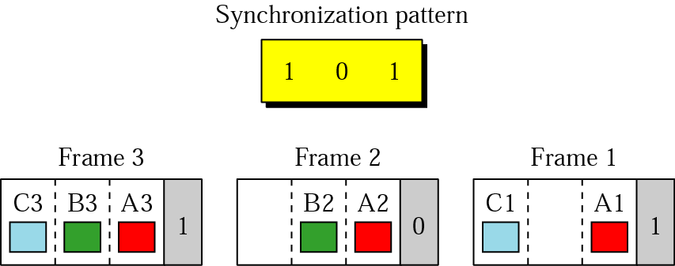
Frame Synchronizing
Synchronization between the multiplexing and demultiplexing is a major issue in TDM.

Slide 25
Example 4: We have four sources, each creating 250 characters per second. If the interleaved unit is a character and 1 synchronizing bit is added to each frame, find (a) the data rate of each source, (b) the duration of each character in each source, (c) the frame rate, (d) the duration of each frame, (e) the number of bits in each frame, and (f) the data rate of the link.
1. The data rate of each source is 2000 bps = 2 Kbps.
2. The duration of a character is 1/250 s, or 4 ms.
3. The link needs to send 250 frames per second.
4. The duration of each frame is 1/250 s, or 4 ms.
5. Each frame is 4 x 8 + 1 = 33 bits.
6. The data rate of the link is 250 x 33, or 8250 bps.

Slide 26
Digital Hierarchy
Telephone companies implement TDM through a hierarchy of digital signals, called digital signal (DS) service or digital hierarchy.
- A DS-0 service is a single digital channel of 64 kbps.
- DS-1 is a 1.544 Mbps service; 1.544 Mbps is 24 times 64 kbps plus 8 kbps of overhead. It can be used as a single service for 1.544 Mbps transmissions, or it can be used to multiplex 24 DS-0 channels or to carry any other combination desired by the user that can fit within its 1.544 Mbps capacity.
- and so on……
DS-0, DS-1, and so on are the names of services. To implement those services, the telephone companies use T lines (T-1 to T-4).
DS-0 is not actually offered as a service.
The T-1 line is used to implement DS-1; T-2 is used to implement DS-2; and so on as shown in fig.

Slide 27


Slide 28


DS and T line rates
T-1 Line for Multiplexing Telephone Lines

Slide 29
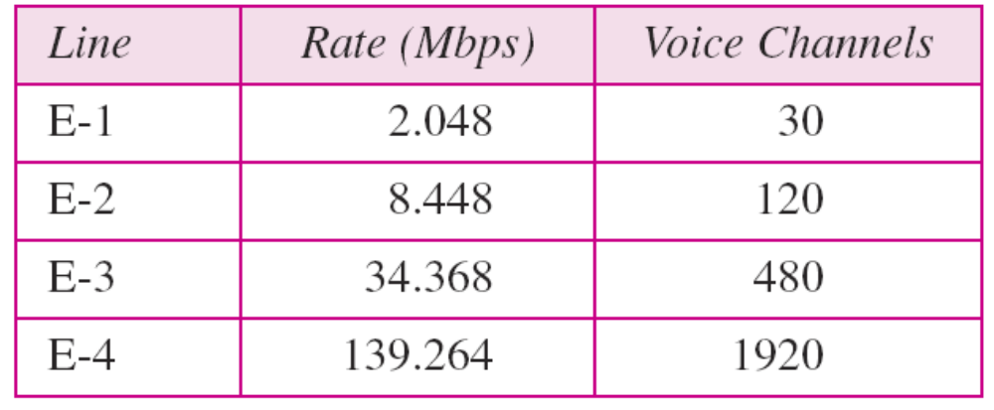
T lines are digital lines designed for the transmission of digital data, audio, or video. However, they also can be used for analog transmission (regular telephone connections), provided the analog signals are first sampled, then time-division multiplexed.
2nd fig. shows how 24 voice channels can be multiplexed onto one T-1 line. The frame used on a T-1 line is usually 193 bits divided into 24 slots of 8 bits each plus 1 extra bit for synchronization (see fig. in the next slide). The sampling rate of 8000 samples/sec and the bits per sample of 8 (as no. of quantization levels are 256) give rise the data rate is equal to 1.544 Mbps – the capacity of the line.
Europeans use a version of T lines called E lines.
The two systems are conceptually identical, but their capacities differ.

Slide 30

T-1 Frame Structure

Slide 31

Statistical TDM
In synchronous TDM, each input has a reserved slot in the output frame. This can be inefficient if some input lines have no data to send.
In statistical TDM, slots are dynamically allocated to improve bandwidth efficiency.

Slide 32
The number of slots in each frame is less than the number of input lines.
The multiplexer checks each input line in round-robin fashion; it allocates a slot for an input line if the line has data to send; otherwise, it skips the line and checks the next line.
A slot carries data as well as the address of the destination. The addressing in its simplest form can be n bits to define N different output lines with n = log₂ N.
Slot size: the ratio of the data size to address size must be reasonable to make transmission efficient.
No synchronization bit: no need for frame-level synchronization.
Bandwidth: the capacity of the link is normally less than the sum of the capacities of each channel.

Slide 33

Spread Spectrum
Combine signals from different sources to fit into a larger bandwidth to prevent eavesdropping and jamming by adding redundancy.
If the required bandwidth for each station is B, spread spectrum expands it to B_{SS}, such that B_{SS} >> B.
There are two techniques to spread the bandwidth: frequency hopping spread spectrum (FHSS) and direct sequence spread spectrum (DSSS).

Slide 34

FHSS
Uses M different carrier frequencies that are modulated by the source signal.
At one moment, the signal modulates one carrier frequency; at the next moment, the signal modulates another carrier frequency.

Slide 35

Fig. shows general layout for FHSS.
A pseudorandom code generator, called pseudorandom noise (PN), creates a k-bit pattern for every hopping period T_{h}.
The frequency table uses the pattern to find the frequency to be used for this hopping period and passes it to the frequency synthesizer.
Frequency synthesizer creates a carrier signal of that frequency, and the source signal modulates the carrier signal.

Slide 36

Assume there are eight hopping frequencies (M = 8, and k = 3), as shown in the table. The pseudorandom code generator will create eight different 3-bit patterns, that are mapped to eight different frequencies.
Note that the pattern is pseudorandom it is repeated after eight hoppings.
FHSS cycles

Slide 37

If there are many k-bit patterns and the hopping period is short, a sender and receiver can have privacy.
If the number of hopping frequencies is M, M different stations can use the same B_{SS}.
In FDM, each station uses 1/M of the bandwidth, but the allocation is fixed; in FHSS, each station uses 1/M of the bandwidth, but the allocation changes hop to hop.

Slide 38

DSSS
Replace each data bit with n bits using a spreading code
Each bit is assigned a code of n bits, called chips, where chip rate is n times that of the data bit. This means that the required bandwidth for the spread signal is n times larger than the bandwidth of the original signal.
A special type of sequence code that allows the combining and separating of spread signals, only allows the bandwidth sharing.

Slide 39

As an example, let us consider the sequence used in a wireless LAN, the famous Barker sequence where n is 11. Assume that the original signal and chips in the chip generator use polar NRZ encoding.

